Slide 1
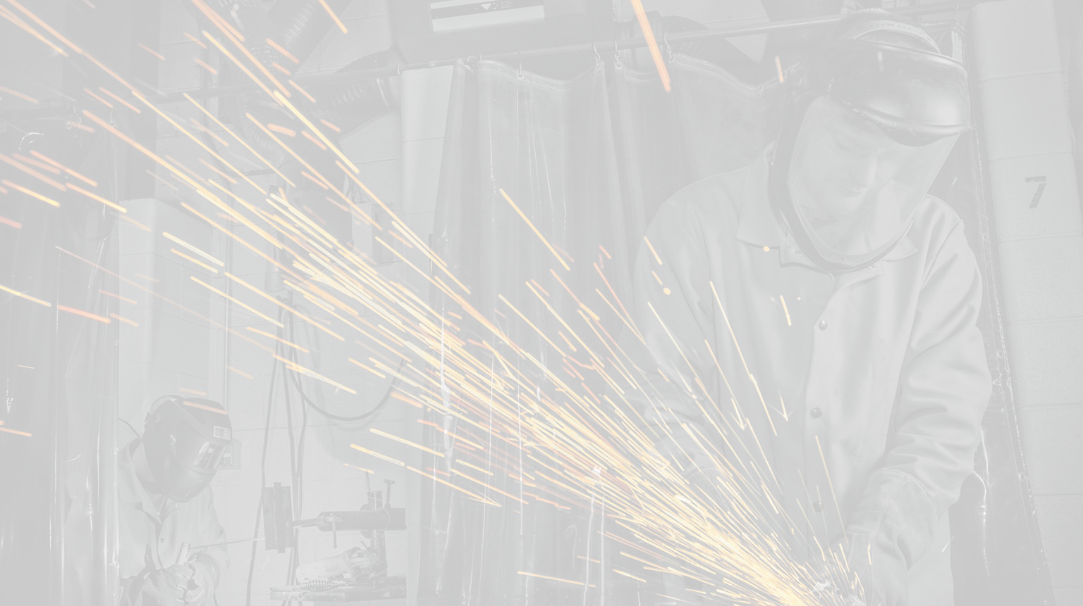

NORTH AMERICA’S
BUILDING TRADES UNIONS
TradesFutures
MC3 in the Schools:
A Guide for CTE Teachers, Administrators and School Counselors

Slide 2
North America’s Building Trades Unions
NABTU is an alliance of 14 national and international unions in the building/construction industry that collectively represent over 3 million skilled craft professionals in the US and Canada. Each year, our unions and contractor partners invest over $1.6 billion in private-sector funds to operate 1,900 apprenticeship training centers across North America.
These schools produce the safest, most highly trained, and productive skilled craft workers in the world.
NABTU is dedicated to creating economic security and employment opportunities for all construction workers by safeguarding wage and benefits standards, investing in our renowned apprenticeship and training system, and creating pathways to the middle class for women, communities of color and military veterans in the construction industry.

Slide 3

Registered Apprenticeship
What is Registered Apprenticeship?
When apprenticeship program sponsors voluntarily request state or federal approval [registration] for their training programs, they also voluntarily choose to come under various state or federal regulations affecting the standards, duration and quality of their training.
The approved apprenticeship training standards set forth the terms and conditions of training – with the goal of protecting apprentices from exploitation.
Registered Apprenticeship – the gold standard in US workforce development.

Slide 4


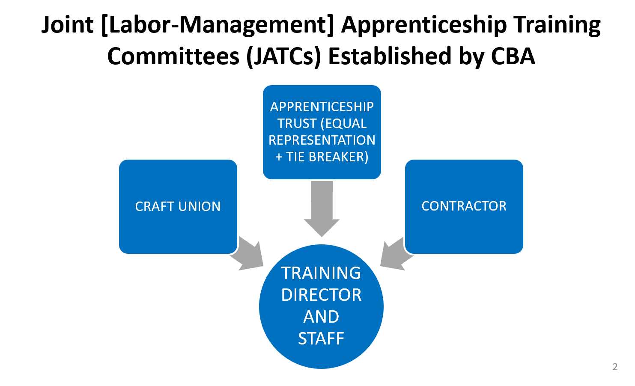
Building Trades Registered Apprenticeship
4

Slide 5
Building Trades Registered Apprenticeship
Building Trades Registered Apprenticeship
NABTU’s “earn while you learn” registered apprenticeship programs have all been assessed for college credit (with no student debt).
Many Building Trades registered apprenticeship programs have articulation agreements with local community colleges.
Once apprentices complete their indenture, they have the skills, nationally-recognized certifications, and college credits they can take anywhere in the US.

Slide 6
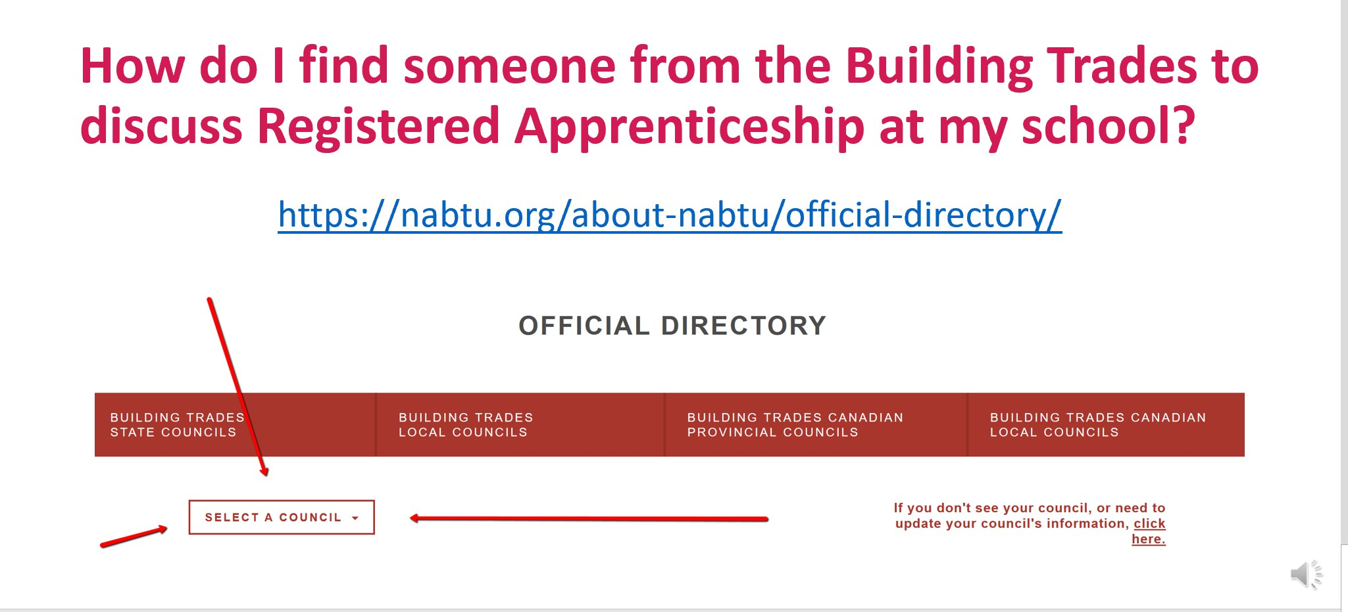
14

Slide 7
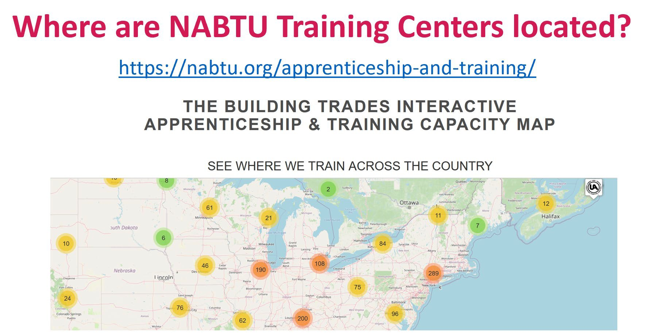
15

Slide 8
Apprenticeship Readiness Programs (ARPs)
Ladders to the Middle Class
TradesFutures sponsors comprehensive apprenticeship-readiness training programs (ARPs) throughout the US. These 220 programs provide a gateway for local residents, focusing on women, people of color, and transitioning veterans, to gain access to Building Trades’ registered apprenticeship programs. More than 60 programs are conducted in school-based settings (High Schools, CTE Schools, Alternative Schools) across the country.
ARPs are administered by state and local Building Trades Councils and they teach the nationally recognized Multi-Craft Core Curriculum (MC3).

Slide 9
Apprenticeship Readiness Programs (ARPs)
How Do Building Trades ARPs Work?
Apprenticeship Readiness Programs are sponsored by State and Local Building Trades Councils, Training Coordinators, Contractors and JATCs in partnership with local community groups, workforce development boards and schools – both community colleges and secondary schools.
ARPs teach the Multi-Craft Core Curriculum (MC3), TradesFutures’ comprehensive, 120-hour construction registered apprenticeship preparation curriculum.

Slide 10
Apprenticeship Readiness Programs (ARPs)
Why Teach the MC3 in our Schools?
TradesFutures ARPs that teach the MC3 are ladders to the middle class.
Building Trades apprenticeship programs serve as a pathway to middle-class career opportunities – with good pay and benefits offered by the Building Trades’ contractor partners. According to the Bureau of Labor Statistics, median weekly earnings in construction for union members in 2023 was more than $400 higher than that of non-union workers.

Slide 11
Apprenticeship Readiness Programs (ARPs)
Why Teach the MC3 in our Schools?
One of the primary goals of the MC3 is greater diversity in construction registered apprenticeship.
The MC3 was specifically designed to provide opportunities for underserved populations in the construction industry, including women, people of color and transitioning veterans. Of the 22,900 adults and CTE students who successfully completed the MC3 between 2016 and 2023, 80% were from communities of color and 20% were female.

Slide 12
Apprenticeship Readiness Programs (ARPs)
Why Teach the MC3 in our Schools?
The MC3 is high quality educational content. The MC3 was created to provide high quality, apprentice-level content to young people and adults interested in construction, to prepare them for life-long learning and careers in the industry.
After they complete the MC3 and graduate, your students may join the Building Trades and work among the safest working, most highly skilled construction workers in the world.
The MC3 has been certified by state education departments in a number of states across the country.

Slide 13
Apprenticeship Readiness Programs (ARPs)
Why Teach the MC3 in our Schools?
The MC3 is the bridge that connects two high quality education systems – America’s great secondary schools and the Building Trades registered apprenticeship programs.
If your students complete the MC3 and join a registered apprenticeship program, they will join one of the largest privately-funded workforce development systems in the nation.

Slide 14
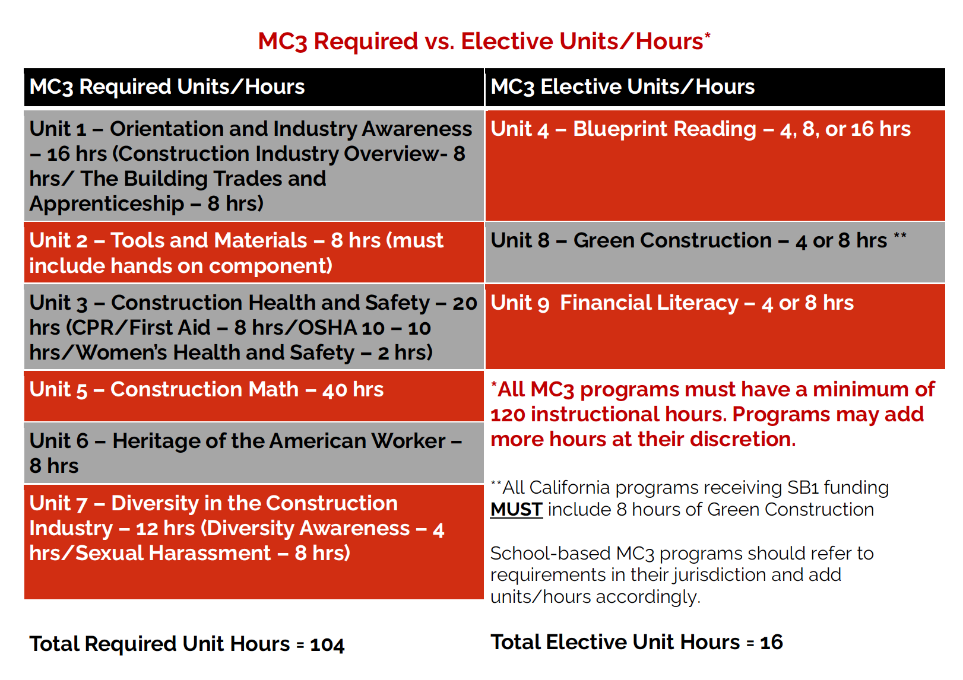
The Multi-Craft Core Curriculum

Slide 15

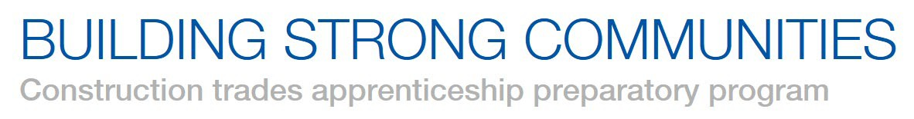

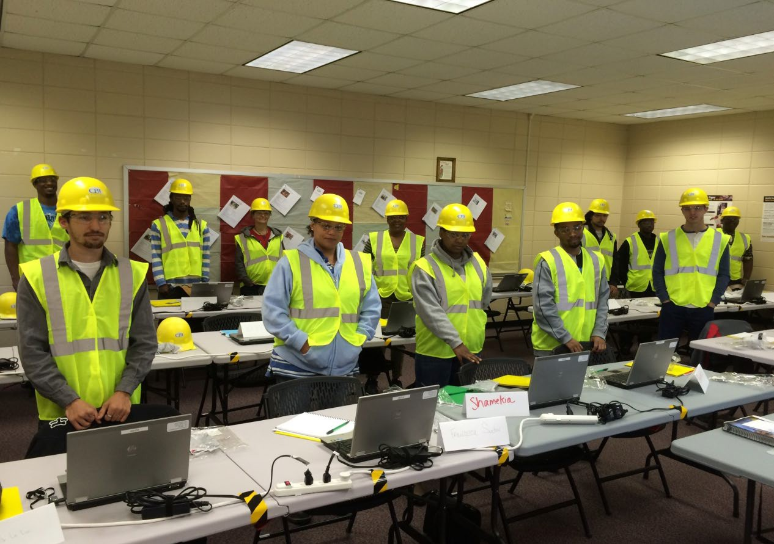
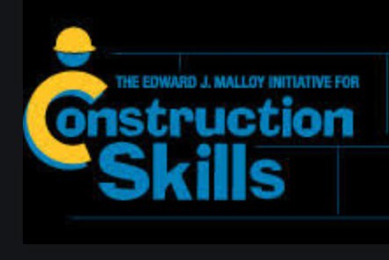




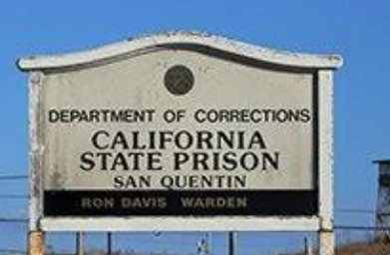



Apprenticeship Readiness Programs (ARPs)

Slide 16
Overview of NABTU and TradesFutures
North America’s Building Trades Unions (NABTU)
TradesFutures
A labor organization representing more than 3 million skilled craft professionals across the United States and Canada
In partnership with construction industry employers, NABTU and its affiliates sponsor and promote Registered Apprenticeship (RA) training programs
NABTU’s RA programs comprise one of the largest post-secondary education programs in the country
Produce the safest, most highly trained, productive skilled craftworkers found anywhere in the world
A non-profit corporation organized for the purpose of developing, promoting, and improving Apprenticeship Readiness Programs (“ARPs”)
Administers the Multi-Craft Core Curriculum (MC3), an apprenticeship readiness curriculum designed to prepare students for careers in the Building Trades
Sponsors and promotes over 200 ARPs across the United States
After graduating from an ARP, students will transition into NABTU’s RA programs

Slide 17

Contact Us
Please reach out to NABTU with all Registered Apprenticeship inquiries:
Please reach out to TradesFutures with all Apprenticeship Readiness/MC3 inquiries:
202-347-1461
202-347-1461
INFO@NABTU.ORG
PROGRAM@TRADESFUTURES.ORG
@northamericasbuildingtradesunions
@tradesfutures
@nabtu
@trades_futures
WWW.NABTU.ORG
WWW.TRADESFUTURES.ORG

